Slide 2
Design Workshops: Requirement gathering
Duration: 40 mins
Session by: TBD

Slide 3
Design Workshops: Requirements gathering
Know what is requirement gathering
When and how to gather requirements
Get to know the different types of workshops
Best practices to conduct a workshop
At the
end of
this session:

Slide 4
Let’s plan a tour!
Notes:
This is a small ice breaking session, Which makes the audience to answer for this question. How they plan for a tour. That is Requirement Gathering.
We will tell audience to put their thoughts on a mural board like Place, Duration, Budget etc. So we gather a large amount of Data. Will use the same Data for our exercise at the end of the session.(Which is nothing but an affinity diagram)
What do we Do?
Take the audience to the Mural board with the link given below and divide them into 2 groups and make them participate in the exercise.
Duration: 15 minutes
Link -

Slide 5
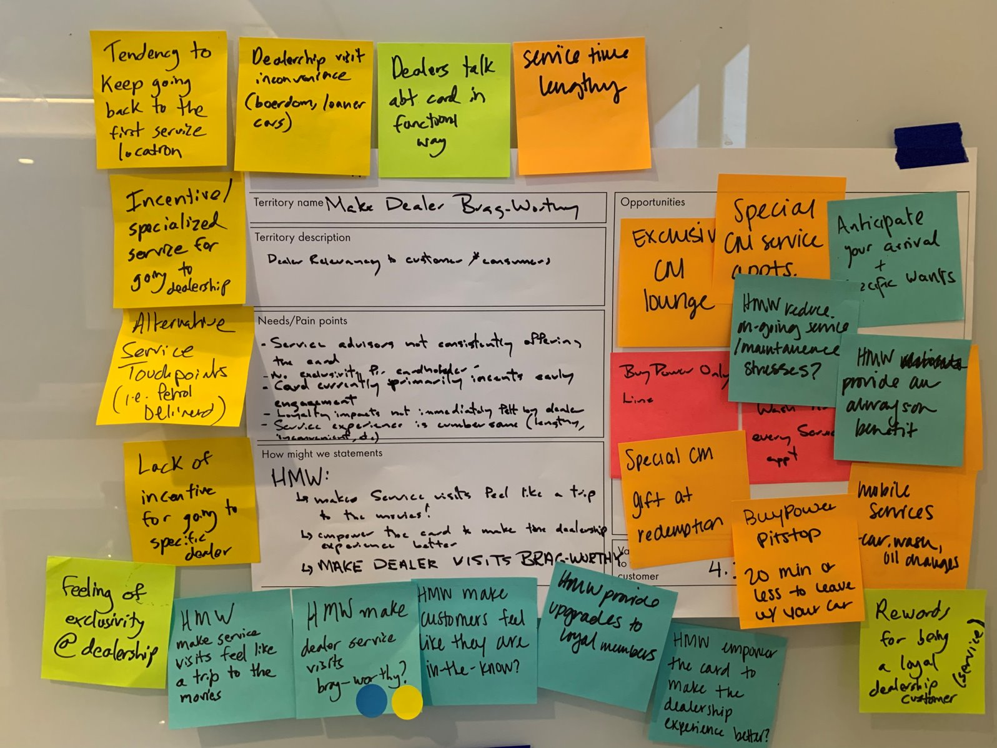
Why do we need to gather requirements?
Design Workshops: Requirements gathering
Understand users and their needs.
Set project goals and objectives
Understand business goals from a stakeholder’s point of view and align these goals with those of users
Eliminate ambiguity and misunderstanding
Understand direction and scope of the project
Notes:
This gathering process occurs before designers begin working on a project to guide early research and set goals and expectations. They must understand user needs, business goals, technical specifications/limitations before starting the project.
It’s simply a foundational understanding of the user experience, so UX designers know where to begin. For example, how do UX researchers begin researching users if they don’t know who they are? The UX gathering process tells designers where to start and what metrics determine a successful project completion.

Slide 6
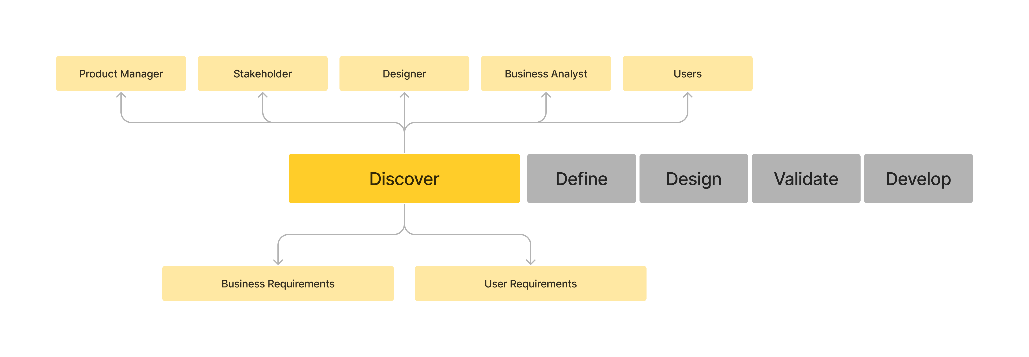
When do we gather requirements?
Design Workshops: Requirements gathering
Notes:
This to show when does the requirement gathering occurs in the UX journey
Replace the Picture.

Slide 7
Key areas of requirements gathering
Design Workshops: Requirements gathering
User requirements
Identify primary users
User demography
Satisfaction with product
User goals
Business requirements
Business goals
Business strategy
Project scope and constraints
Project roadmap
Competitive landscape
Who takes responsibility?
UX leads or designers
Researcher
Who takes responsibility?
Business analyst
Product manager
UX lead/ designers

Slide 8





Steps to gather requirements
Design Workshops: Requirements gathering
IDENTIFY KEY STAKEHOLDERS &
END-USERS
UNDERSTAND
OBJECTIVES OF THE PROJECT
CONDUCT WORKSHOPS TO GATHER INPUTS
CREATE A CONCISE REQUIREMENT DOCUMENT
VALIDATE & VERIFY DOCUMENT WITH STAKEHOLDERS
Notes:
Show the process of the requirements gathering

Slide 9
How to gather requirements
Design Workshops: Requirements gathering
IDENTIFY KEY STAKEHOLDERS &
END-USERS
UNDERSTAND
THE OBJECTIVES OF THE PROJECT
CONDUCT WORKSHOPS TO GATHER INPUTS
CREATE A CONCISE REQUIREMENT DOCUMENT
VALIDATE & VERIFY DOCUMENT WITH STAKHOLDERS
Notes:
Show the process of the requirements gathering

Slide 10

Design workshops
Design Workshops: Requirements gathering
What are design workshops?
Workshops are intensive collaborative sessions used to solve problems and enable progress on a particular challenge throughout the design timeline. Workshops enable participants to come together for a concentrated time of idea generation and hands-on
What are the benefits of doing workshops?
Breaking silos and getting different perspectives from the team members belonging to different domains like development, design and business.
By involving stakeholders in the process and co-creating, it's easier to get their buy in.

Slide 11





Types of workshops
Design Workshops: Requirements gathering
DISCOVERY
WORKSHOP
EMPATHY
WORKSHOP
DESIGN
WORKSHOP
PRIORITIZATION
WORKSHOP
CRITIQUE
WORKSHOP

Slide 12

Discovery workshop
Design Workshops: Requirements gathering
The goal of a discovery workshop is to create consensus for project milestones and plans. Discovery workshops can be a useful tool for helping UXers:
Understand requirements at the beginning of an initiative
Gather existing knowledge from client or stakeholder teams
Create consensus on plans and priorities for a project
Exercises/ Examples:
Affinity diagramming | CoCreation | MosCow
Notes:
Common Scenarios for Discovery Workshops Discovery Workshops typically occur at the beginning of a project or at the beginning of significant key substages of a project when there is a need to: Understand existing research and gather existing knowledge in order to determine additional research plans over the course of the project Understand stakeholder expectations Build a mutual understanding of the overall project direction, key milestones, and vision for the entire team Get a glimpse into the broader context (e.g., culture, parallel efforts, etc.) that may affect the project When to Have a Discovery Workshop Some common opportunities for Discovery Workshops across a high-level design process are shown in the timeline below: Soon after project initiation so that alignment can be created around overall goals, and the core team can gather existing information from stakeholders or clients At key milestones with the project, such as small subphase kickoffs, where the core team can have focused information gathering with the subteam involved closely in that subphase

Slide 13

Empathy workshop
Design Workshops: Requirements gathering
The goal of an empathy workshop is to help teams or stakeholders understand and prioritize user needs before designing a solution. Empathy workshops are used to:
Understand who the relevant customers or users are
Gain clarity and consensus on user needs, motivations and behaviors
Build empathy for users
Exercises/ Examples :
Empathy Mapping | User Personas | SAIL boat
Notes:
Common Scenarios for Empathy Workshops Empathy workshops typically occur at the beginning of a project or after some user research has been completed in order to: Shift stakeholder perspectives from a features-first mindset to a user-first mindset, Prime stakeholders with a user-centric attitude as the project gains momentum Share compelling user-research insights that may influence future design directions When to Have an Empathy Workshop Some common opportunities for empathy workshops across a high-level design process are: As soon as the project kicks off, so that you can share existing user insights with stakeholders, priming them to adopt a user-centric mindset from the beginning After new research has been conducted, so you can share results in order to shape a new potential design direction for the project

Slide 14

Design workshop
Design Workshops: Requirements gathering
The goal of a design workshop, sometimes called a design-studio workshop, is to rapidly generate and discuss a wide set of ideas. Design workshops are used to:
Utilize idea-generation activities like sketching to encourage discussion
Incorporate cross-disciplinary perspectives
Create shared ownership in project success by inviting others to participate in activities
Exercises/ Examples :
Dot Voting | MOSCOW | Personas
Notes:
Common Scenarios for Design Workshops Design workshops can happen at any “diverge” phase of the design cycle, when there is a need to: Rapidly generate a wide set of ideas for a well-defined design challenge Involve people from different teams to broaden the perspective Dig deep to refine a set of potential concepts or solutions late in the design process Foster shared ownership around a product or UX vision When to Have a Design Workshop Some common opportunities for design workshops across a high-level design process are: At project kick off, in order to build ownership and buy-in for the design process and ideas After a phase of user research, where the insights can be used as inputs for generating useful features or solutions After an initial design phase, in order to refine design directions and explore deep-level user flows or journeys (as opposed to feature ideas)

Slide 15

Prioritization workshop
Design Workshops: Requirements gathering
The goal of a prioritization workshop is to build consensus on which features customers (or other stakeholders) value most and prioritize them. Prioritization workshops are used to:
Refine and rank features or ideas
Create focus
Build consensus on which goals, ideas or user groups to prioritize
Exercises/ Examples :
MosCow | RICE Method | KANO Model
Notes:
Common Scenarios for Prioritization Workshops Prioritization workshops are beneficial any time critical decisions need to be made or when the team needs to agree on an action plan, such as when: There are too many competing priorities Stakeholders are asking for too much and there is scope creep or feature overload You need to weigh the value of planned feature releases against each other in order to shape a roadmap You want to bring sponsored users into the process in order to have them weigh in on features or items that they value most When to Have a Prioritization Workshop Some common opportunities for prioritization workshops across a high-level design process are: At the onset of a project, if there are many competing internal initiatives, and you need an understanding of how to prioritize timelines or resources During user research, when you can bring users together in order to influence the prioritization of feature development Later in the process, after design is already underway, if you experience scope creep and need to reset on what is truly prioritized

Slide 16

Critique workshop
Design Workshops: Requirements gathering
The goal of a critique workshop is to provide space in our design process so that design decisions align to user needs. Critique workshops can be a useful tool in helping teams:
Evaluate existing content or designs with user needs as a lens
Rapidly identify quick fixes for optimization
Note necessary long-term evolutions or optimizations
Exercises/ Examples :
Round Robin| Working Wall | CoCreation
Notes:
Common Scenarios for Critique Workshops Consider using a critique workshop as a checkpoint before new design projects begin, or at intermittent design reviews, such as when there is a need to: Understand how well the design supports usability heuristics or design principles established by the team Discuss the user flow through a design, by examining each screen or flow through the lens of a specific user group or persona Hear perspectives from different expertise areas and feedback from teammates with different job functions Explore the designs of competing products or other experiences that have elements or qualities that you want to achieve When to Have a Critique Workshop Some common opportunities for critique workshops across a high-level design process timeline might be: At the beginning of a project, where the team reviews the existing design against known goals, heuristics, or principles in order to shape the new design As part of an iterative design cycle, where quick, regularly occurring critiques keep the design on track

Slide 17
To-do's
Design Workshops: Requirements gathering
Before the workshop
During the workshop
After the workshop
Identify the purpose & outcomes
Identify key stakeholders
Set clear agenda
Schedule place/time
Arrange logistics & equipment
Start with purpose/desired outcomes
Use agenda/activity to drive
Document the requirements
Playback captured requirements
Prepare and share
Decisions taken
Actions ahead
Formal sign-off

Slide 18
UX workshop rules
Design Workshops: Requirements gathering
Everyone Participates
Build on the ideas of others
Be visual
We mean everyone regardless of age or roles.
Encourage the ideas of other participants when the topic is important
Write all the inputs on the board
Stay focused on the Topic
One conversation at a time
No HiPPOs
Don't deviate from the main topic
Avoid having side conversations
The highest paid person’s opinion - NOPE

Slide 19
I can’t get my team to say anything!
An unexpected client just arrived.
Whose group do they go in?
What if we don’t get any good ideas?
I’m STARVING and no break in sight
How does this activity work again??
What if my Internet goes out while I’m moderating a breakout group?
Avoid behind the scenes

Slide 20
When
you are confronted with many facts or ideas in apparent chaos
issues seem too large and complex
group consensus is necessary
Typical situations are:
After collecting the inputs
When collecting and organizing large data
When developing relationships or themes among ideas
When reducing attributes to categories that can be addressed at a higher level
Activity
Affinity
Diagram
It is a collection of large amounts of data that is organized into groups or themes based on their relationships.
Notes:
This is just one of the example of post workshop.
What is an Affinity Diagram?
An affinity diagram is a collection of large amounts of data that is organized into groups or themes based on their relationships. The affinity diagram process is great when you want to make sense of insights gathered during research, as well as when you want to organize ideas generated during ideation sessions.
https://miro.com/blog/create-affinity-diagrams/
Group Them – Location, Mode of travel, Duration, Packing, Things to Do and Budget.

Slide 21
To wrap up
Design Workshops: Requirements gathering
Gathering requirements
It is a process that can take time and effort but is a non-negotiable. No matter the brand or industry, design teams need direction – they need to know what they’re aiming for.
That is the role of the requirements:
It gives you scope, limitations, definitions and goals.
Workshops
It can be scaled, combined or otherwise adapted to be more effective or appropriate for specific UX challenges.
For example, you might host a discovery workshop that employs prioritization exercises in order to build consensus, or you might facilitate a design workshop that encompasses elements of critique in order to continue refining ideas after ideation.
Notes:
Gathering Requirements - https://www.justinmind.com/blog/gathering-requirements/
Design Workshops - https://adamfard.com/blog/ux-workshop

Slide 22
Q&A

